Slide 1

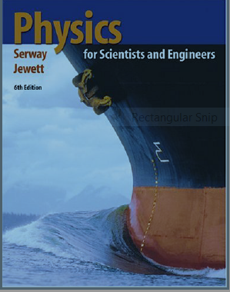


Slide 2
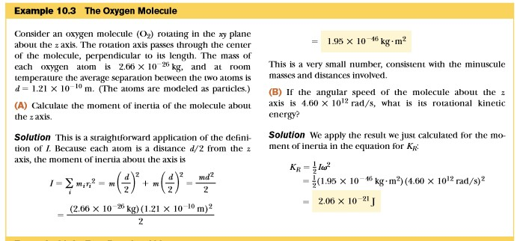
The Moment of Inertia

Slide 3
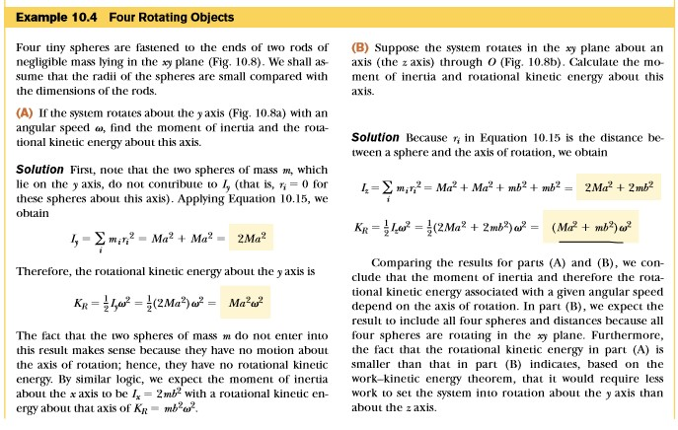

Slide 4
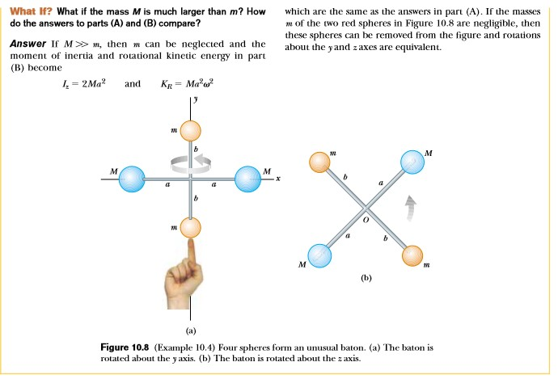

Slide 5
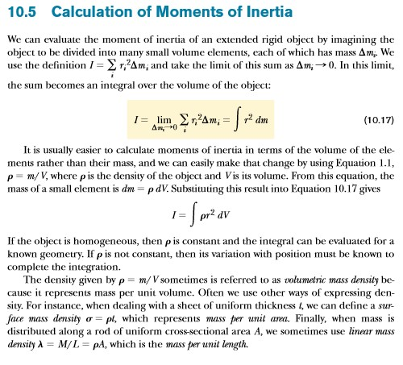
The Volumetric Mass Density Method

Slide 6
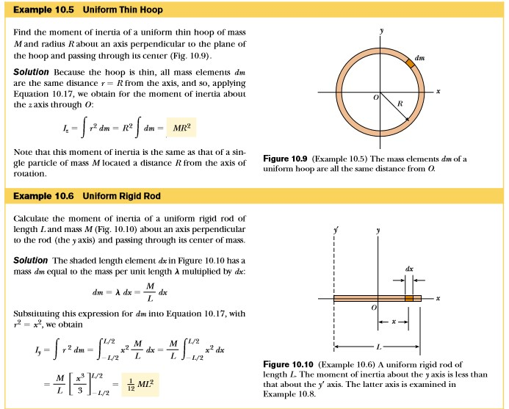

Slide 7
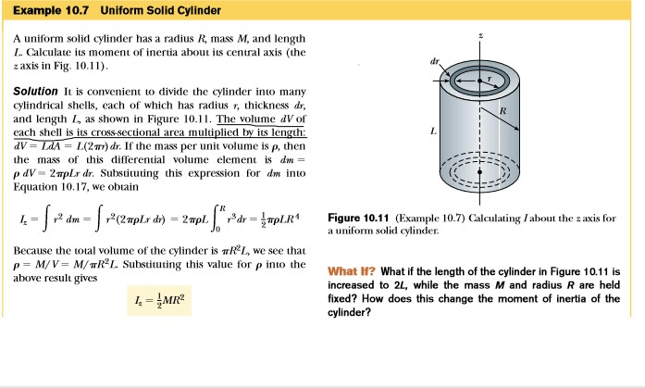

Slide 9
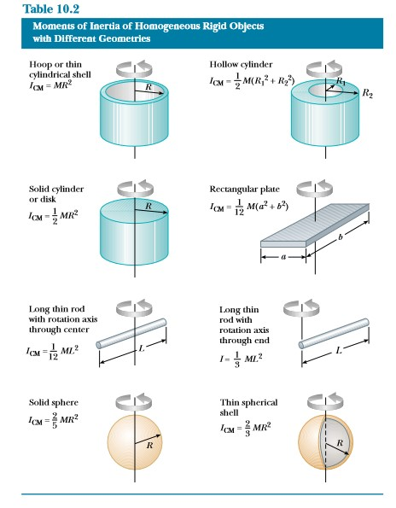

Slide 10
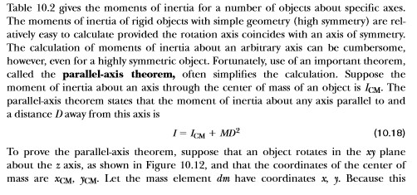

Slide 11
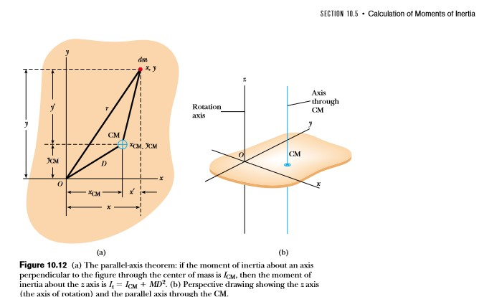

Slide 12
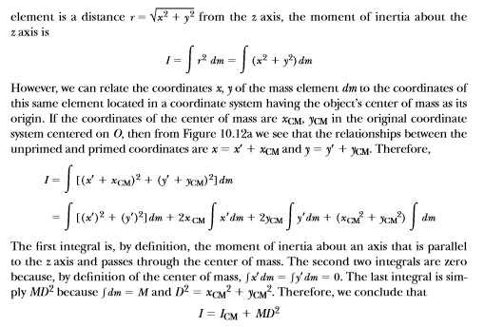

Slide 13



Slide 14
Week end Home Task.
Do the following numericals given at the end of Chapter 10;
Q: 3, 5, 7, 12, 16, 20, 21, 22, 23.

Slide 15
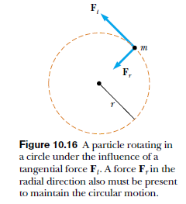
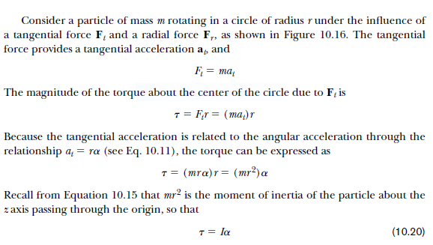

Lecture 5. Torque and Angular Acceleration
The Torque acting on a particle is proportional to its angular acceleration.
Here we have to show, that Ƭ= I α, in angular motion, like F = ma in the linear motion.
The single particle approach.

Slide 16
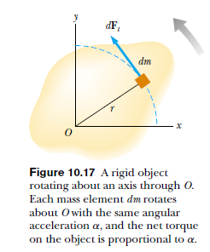


Torque and Angular Acceleration
2. The Rigid Body Approach:

Slide 17
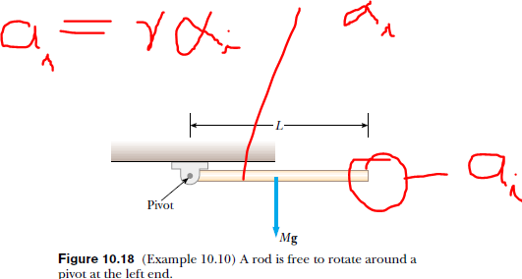
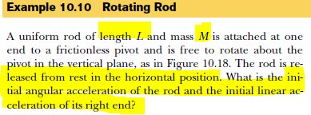

The Rotating Rod (Page #309)

Slide 18
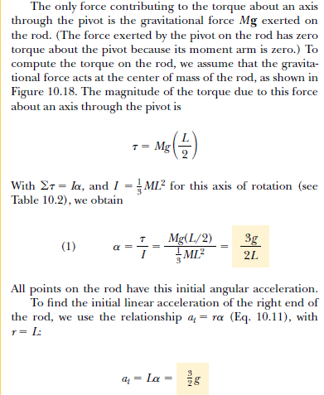

Slide 19
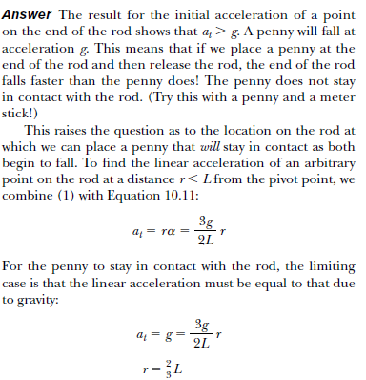
What if we were to place a penny on the end of the rod? Would the penny stay in contact with the rod?

Slide 20
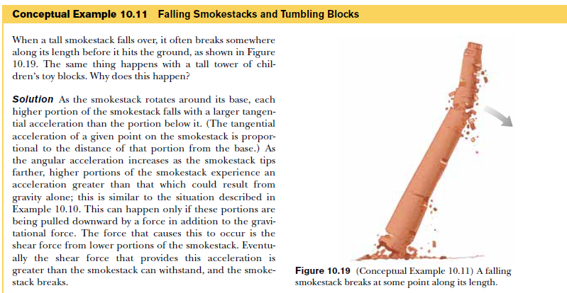
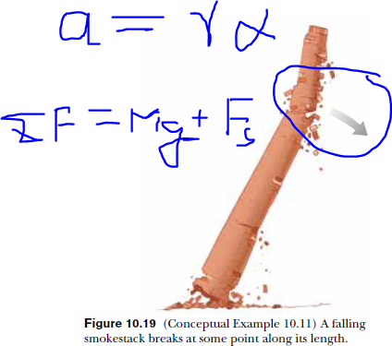

Slide 21
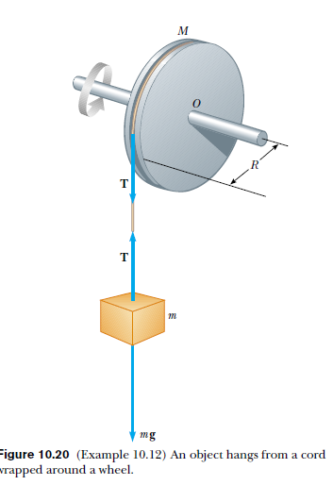

Problem (Page# 310) Home Task
Angular acceleration of a wheel.

Slide 22
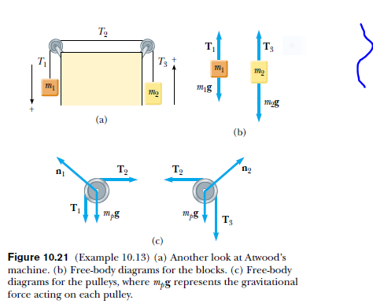

Problem (Page# 311) Home Task
Atwood Machine Revisited

Slide 23
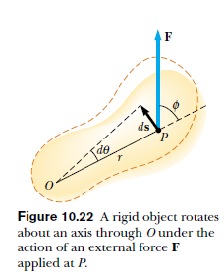


Work, Power and Energy in Rotational Motion ( The Work Energy Theorem in Rotational Motion)

Slide 24
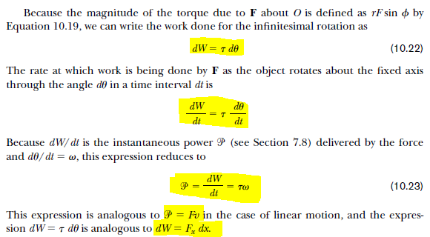

Slide 25
